Slide 1
UNIT 5
Links, Lists & Forms
Introduction to Web Design

Slide 2
Links
Absolute links are links that will lead you to a specific web location on the internet
  Reference address or location is a complete URL (short for Uniform Resource Locator), or more generically known as the web address
  For example, <a href="http://cty.jhu.edu">CTY Website</a>
With a relative link, the reference location is merely a relative location in relation to the directory path of the html file
  For example, <a href="index.htm">Back to Index Page</a> will take the user back to index.htm assuming the current html file is in the same directory of the index.htm file

Slide 3
Links
Here is an example that explains how directories work
  Say, we have an "IWD" directory in our hard drive (C:\IWD), inside the "IWD" there is a "Unit 5" folder (C:\IWD\Unit 5), and inside the "Unit 5" folder there is an "images" folder (C:\IWD\Unit 5\images)
  Then the parent directory (or the directory above) the "images" folder is the "Unit 5" folder, while the parent directory (or the directory above) the "Unit 5" folder is the "IWD" folder
Assume you are in the directory that contains your html file, and there is an "images" sub-directory that contains the image file that you intend to use
  To create an image link (with orange.jpg) that leads users to orange.htm, we use <a href="orange.htm"><img src="images/orange.jpg"></a> to locate the html file and the jpg file accordingly

Slide 4
Links
If your current html file is in another sub-directory (e.g. "example" folder) that is immediately under the parent directory, while both the linked html and the image files are in the parent directory
  To locate both files, we use <a href="../apple.htm"><img src="../apple.jpg"></a> where the two periods bring us to one directory above the current "example" folder
If the current html file is in another sub-directory (e.g. "example" folder) that is immediately under the parent directory, while the linked html file is in the parent directory but the image file is in "images" that is a sub-directory under the parent directory
  We locate the files by using the code <a href="../tomato.htm"><img src="../images/tomato.jpg"></a>

Slide 5
Links
The last attribute of the anchor tag that we cover in this Unit is the ID attribute
  It can make location references within a web page possible
For example, if you add the line <a id="top"></a> immediately after the BODY tag, the "top" ID can be used as an internal reference within the same webpage
  If you add <a href="#top">Back to Top</a> further down the webpage, the "Back to Top" link will direct users to the position where the "top" ID was added, which is the beginning of the webpage in this example

Slide 6
Lists
Lists are important in html because not only can they be used as a way to present information as list items, but they also can be used for creating a menu or navigation bar
The three types of lists are
  Ordered Lists (automatically numbered)
  Unordered Lists (bullet points)
  Definition Lists (terms and explanations)
All lists follow the same pattern:
  <start tag of list> <list item tag> (one or more) </ end tag of list>

Slide 7
Lists (Unordered List)
Unordered lists involves two required tags
  The first one is the <UL> tag
  The second one is the <LI> tag
Both tags are normal tags that require a closing tag
  The Unordered List tags tell that browser that we are creating an unordered list
  The List Item tags create a new item in the list
The CLASS attribute of the UL tag for changing the list-item marker (valid values are disc, circle, and square)

Slide 8
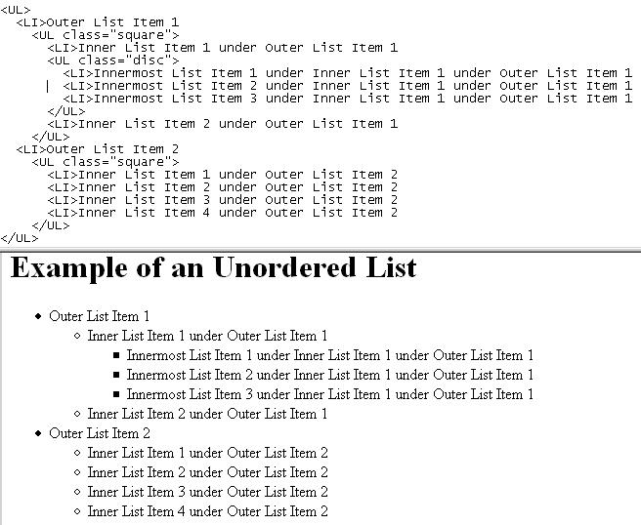
Lists (Unordered List)

Slide 9
Lists (Ordered List)
Ordered lists are very similar to unordered list
  Use the OL tag instead of the UL tag
We can use the TYPE attribute of the OL tag to change the appearance item marker
  The TYPE attribute can take five different values
    The number 1 is the default value and gives a numerical ordered list
    The lowercase a gives a lowercase alphabetically ordered list
    The uppercase A gives an uppercase alphabetically ordered list
    The lowercase i gives a lowercase roman numeral ordered list
    The uppercase I gives an uppercase roman numeral ordered list

Slide 10
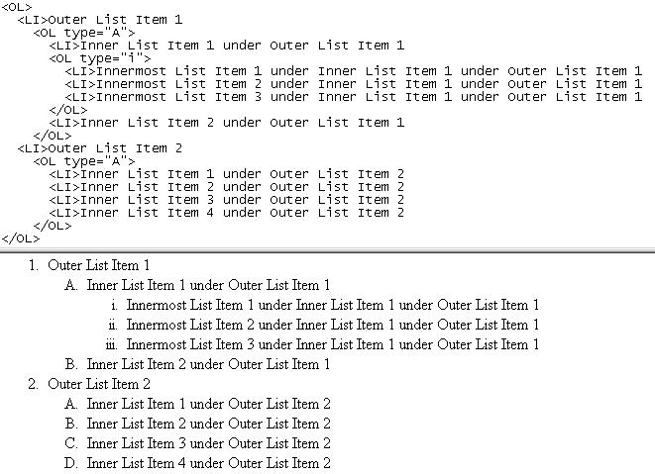
Lists (Ordered List)

Slide 11
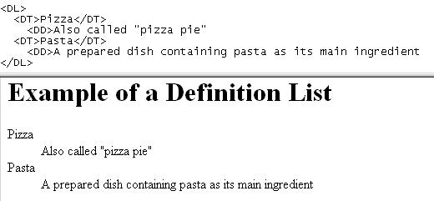
Lists (Definition List)
A definition list looks like a glossary list as its name suggests
The three element tags of a definition list are
  The <DL> tag, meaning Definition List
  The <DT> tag, meaning Definition Term
  The <DD> tag, meaning Definition Description

Slide 12
Forms
Forms are important because it is the most commonly used method for the owners of websites to interact with and receive input and information from their users
To make a web form capable of understanding the user input, we will need to use a scripting language such as PHP, or the even more popular choice, JavaScript to make that happen
Forms in HTML are created by the FORM tag
  There are several tags associated with the FORM tag for us to create different items in a form, such as the INPUT and the TEXTAREA tags

Slide 13
Forms
TEXTAREA tag has few attributes and is rather straightforward
For example, the code <textarea rows="5" cols="20"></textarea> in the BODY area will add a textarea of a size of 5 lines by 20 characters per line in the webpage
  You can add text between the textarea tags if you want to have some text in the textarea

Slide 14
Forms
The more complicated tag of the FORM tag is the INPUT tag
The INPUT tag is a self-closing tag
The TYPE attribute should always be in the INPUT tag because it clarifies what type of control you are going to use
  The control types include
    Textbox, e.g. <input type="text" name="firstTextBox">
    Button, e.g. <input type="button" value="A Test Button">
    Submit button, e.g. <input type="submit" value="Send This Form">
    Reset button, e.g. <input type="reset" value="Reset">
    Checkbox, e.g. <input type="checkbox" name="hobbies" value="biking">
    Radio button, e.g. <input type="radio" name="school" value="elementary">

